Slide 1
Crash reports outside/inside City limits

Slide 2
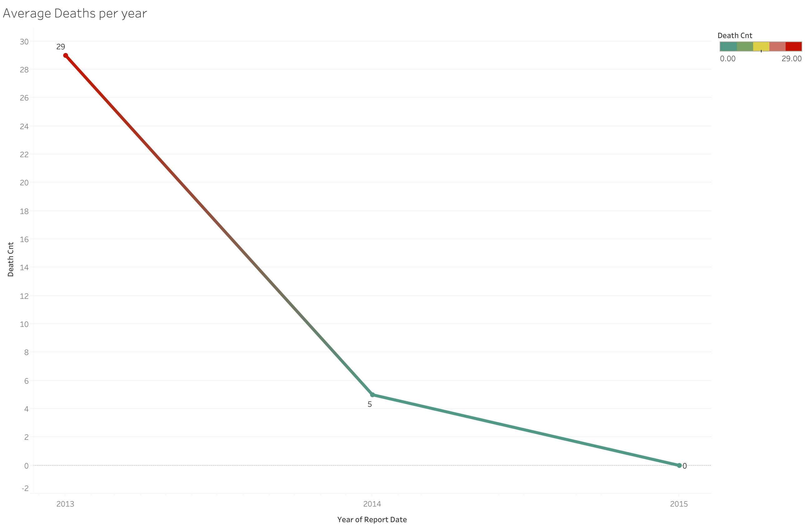

Slide 3
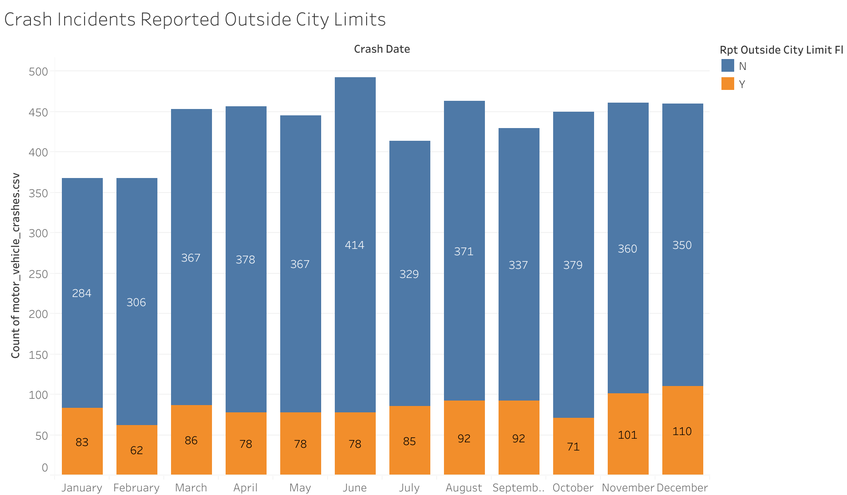
There are more crashes not reported than reported
Maybe due to minor accidents that can be resolved amongst themselves or Accidents resulting in missing person and vehicles
June has the highest number of crashes not reported outside of city limits

Slide 4
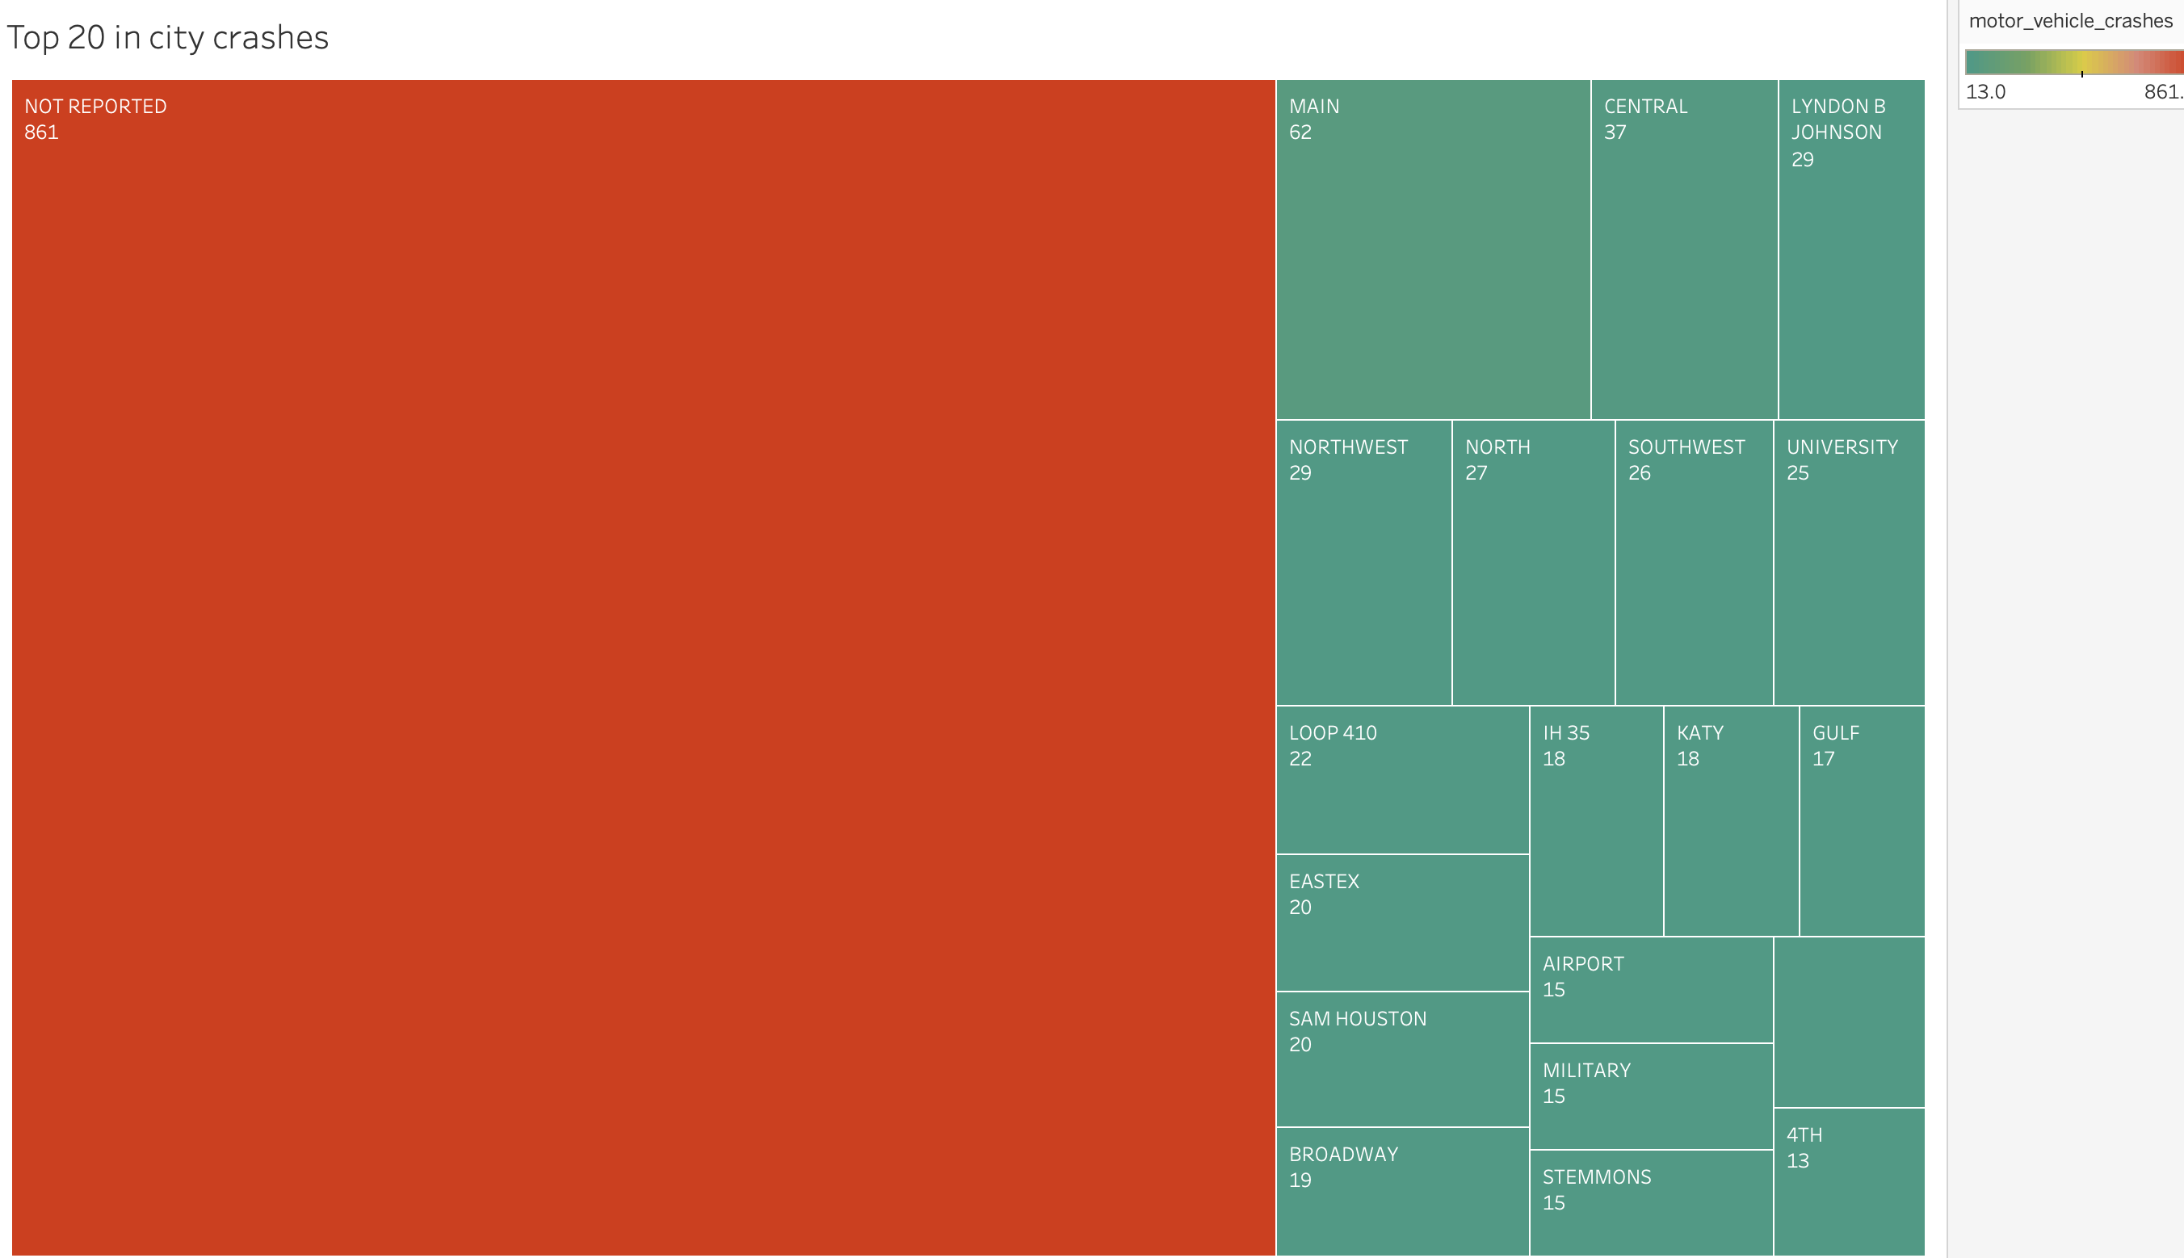
Number of not reported crashes is significant to how many are reported on our streets
Be cautious around main street. May need to come up a different way to direct traffic

Slide 5
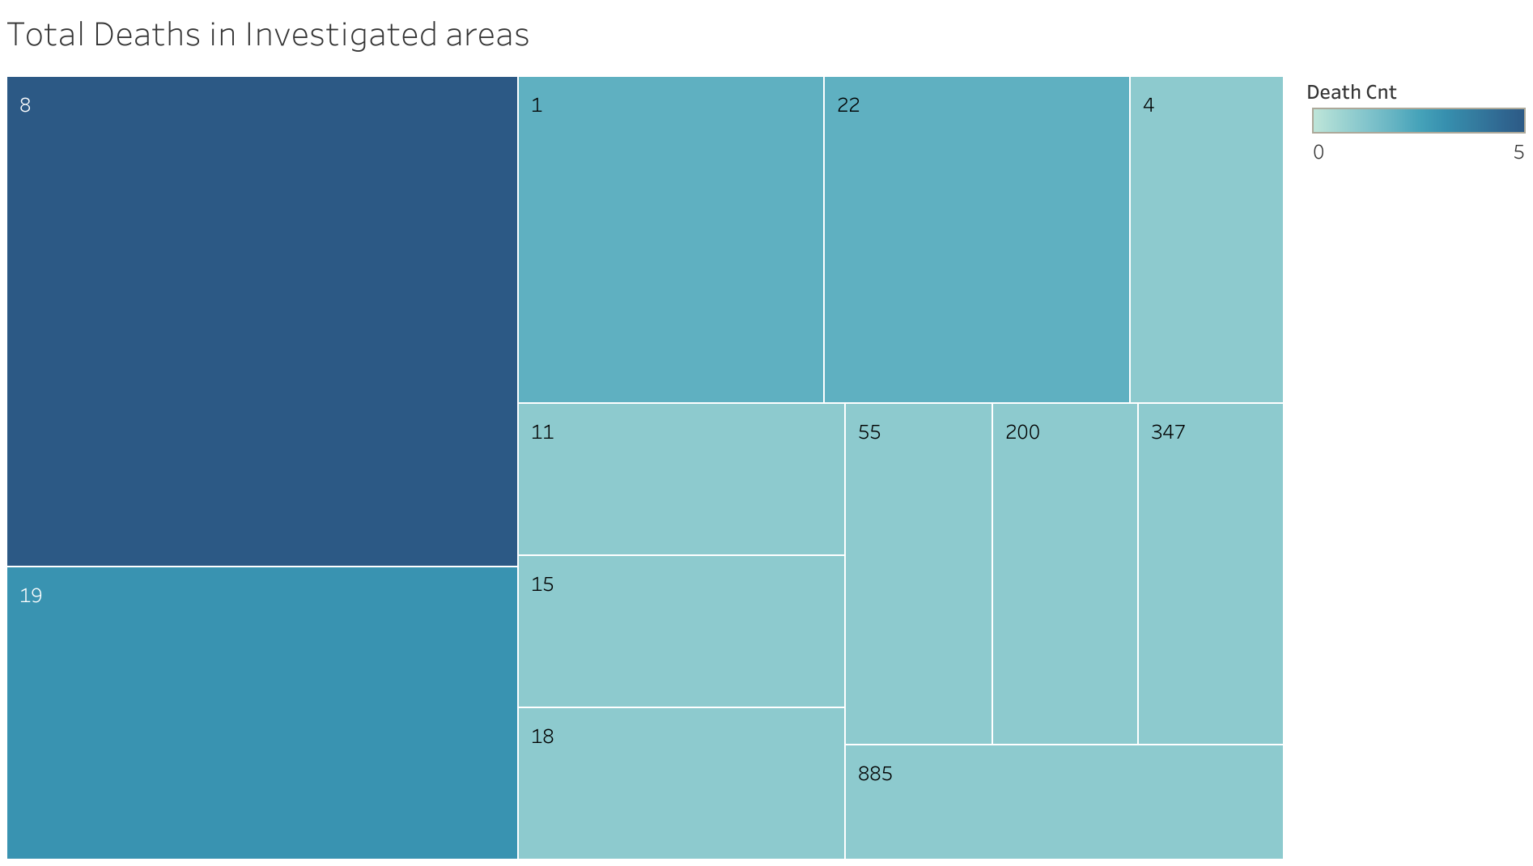
There are at least 1 in 5 deaths from car accidents in these investigated areas
Think of each as area number as zones

Slide 6
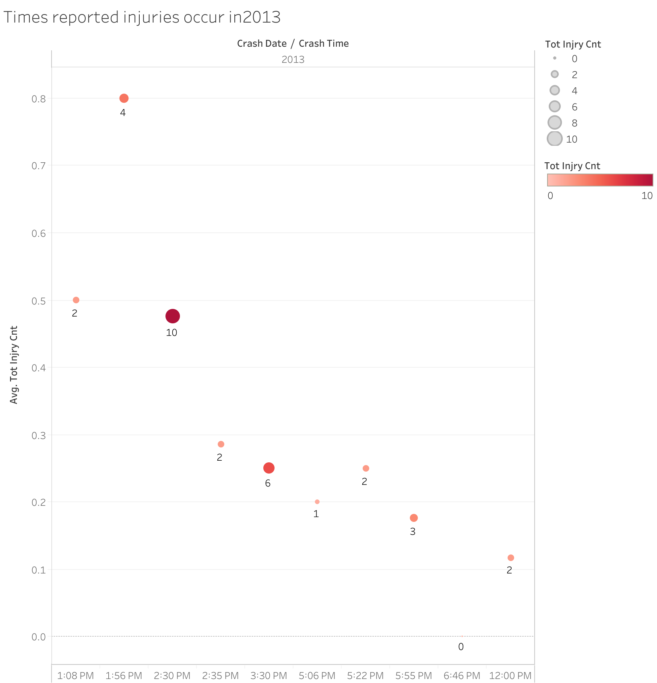

Slide 7
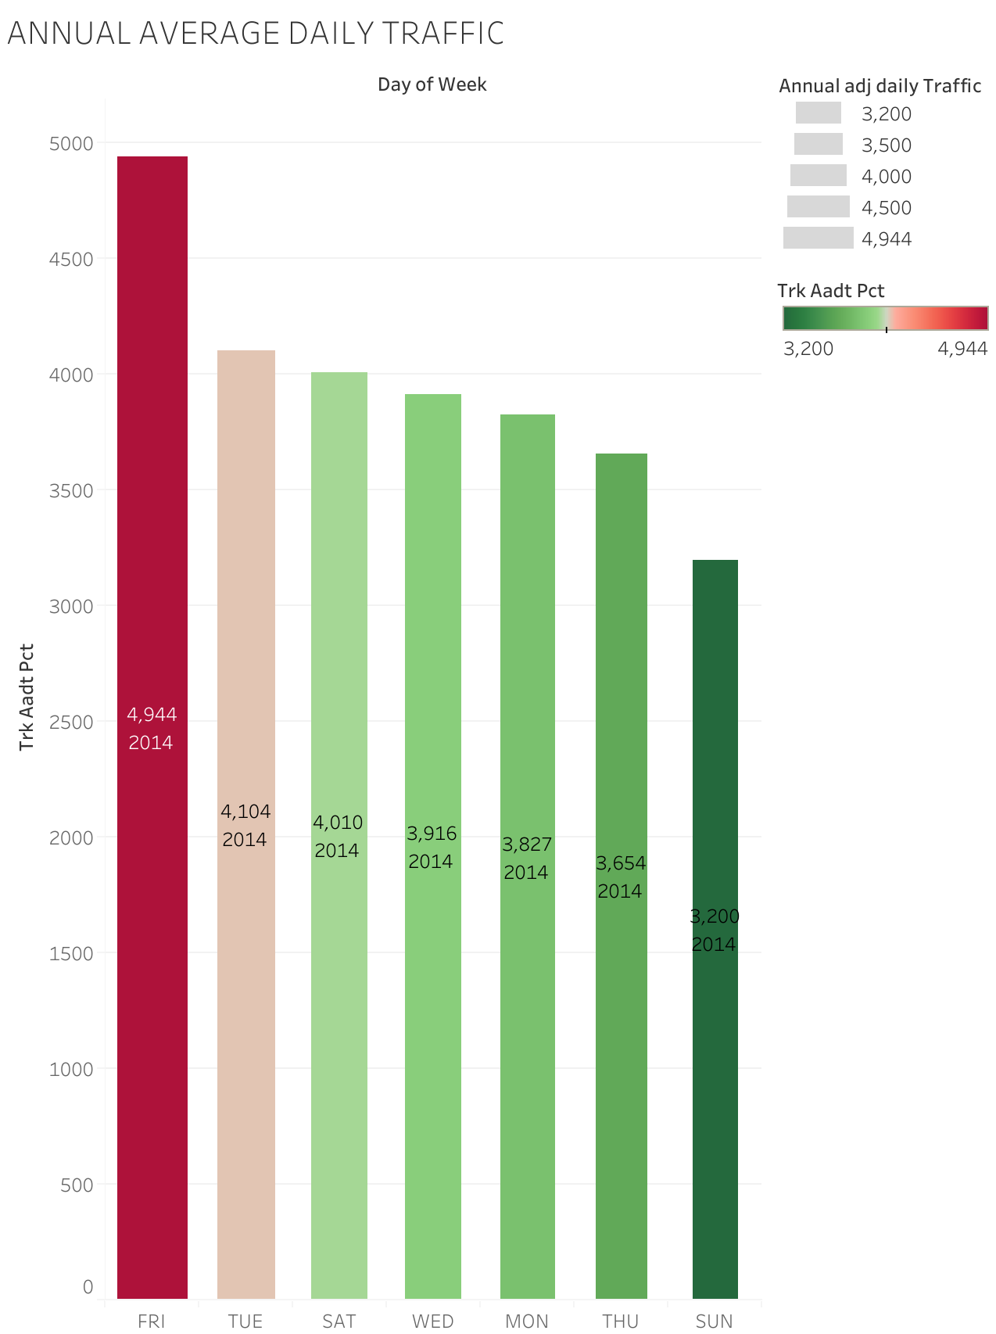
Fridays being the most time people are ready to mingle makes it the number 1 day that most get into the most traffic
Everyone is trying to go out of town, party, and getting off work to enjoy the weekend
Tuesday being second busiest day of the week.

